Slide 1
Electromagnetism
MS864M

Slide 2
Electromagnetic induction
An electrical generating station produces electrical energy by converting other forms of energy such as gravitational potential energy at a hydroelectric plant and chemical energy in a oil-fired plant.
This energy conversion done is through electromagnetic induction (EMI).
http://phet.colorado.edu/en/simulation/faraday

Slide 3
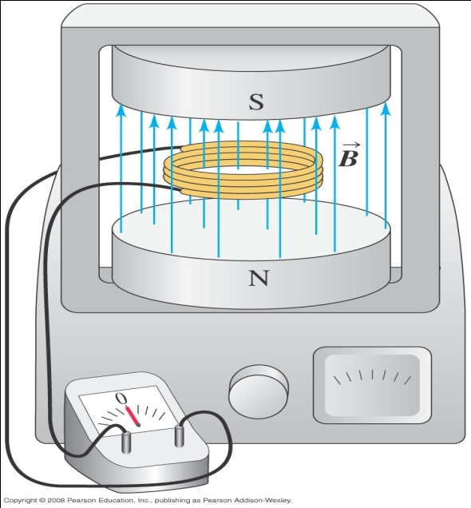
Induction experiment – Changing the magnetic field
When is zero, the galvanometer shows no current.
When is increasing or decreasing, a current flows in the coil.
When reaches a steady value, the current drops to zero regardless of how large is.
Variable magnetic field
Coil connected to galvanometer

Slide 4
Induction experiment – Changing the area
When there is a decrease or increase in cross-sectional area, a current flows only during the change in area.
Rotating the coil a few degrees about a horizontal axis results in a current.
When the coil is pushed into or jerked out of the magnetic field, there is a current.
Variable magnetic field
Coil connected to galvanometer

Slide 5
Faraday’s law of induction
In all these experiments, the current flows when the magnetic flux through the coil is changing.
Faraday’s law states that the induced emf in a closed loop is given by
If the coil has N identical turns, the total rate of change through all the turns is N times as large as for a single turn.
The total emf is therefore

Slide 6
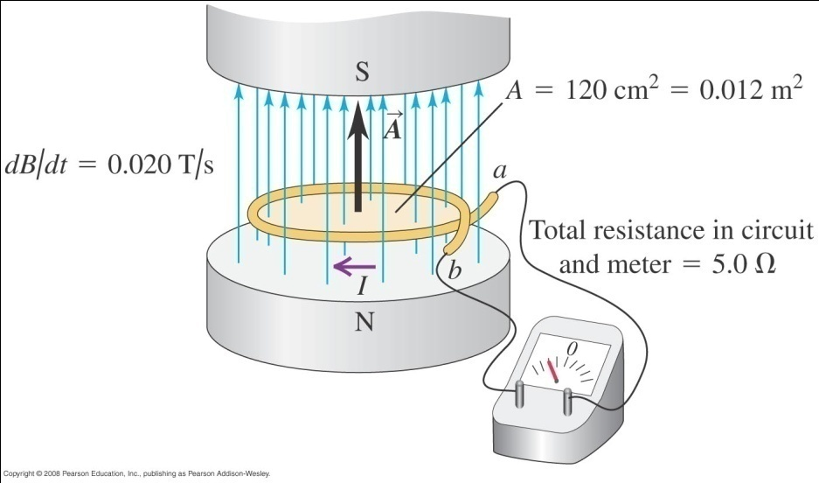
Example 1
The magnetic field between the poles of the electromagnet in the figure below is uniform at any time but its magnitude is increasing at 0.020 T/s. The area of the conducting loop in the field is 120 cm² and the total circuit resistance including the meter is 5.0 Ω.
a) Find the induced emf and the induced current in the circuit.
b) If the loop is replaced by one made of an insulator, what effect does this have on the induced emf and the induced current?
Notes:
V = 0.24 mV, I = 0.048 mA
b) Induced emf does not change but induced current will be smaller.

Slide 7
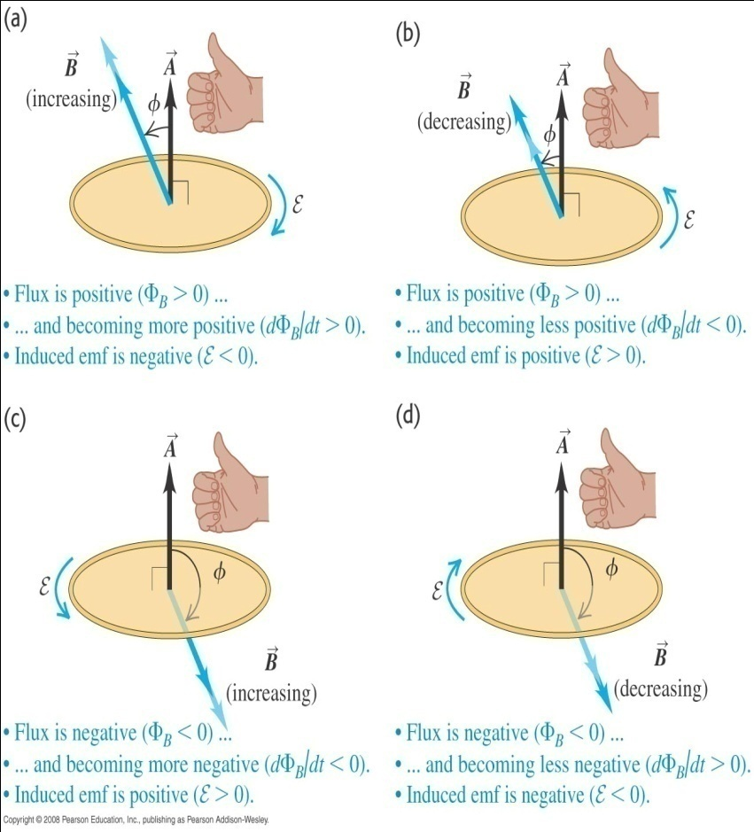
Direction of induced emf
If and are in the same direction and is increasing then is increasing.
If and are in opposite direction and is decreasing then is increasing.
In these two scenarios, the emf is negative.

Slide 8
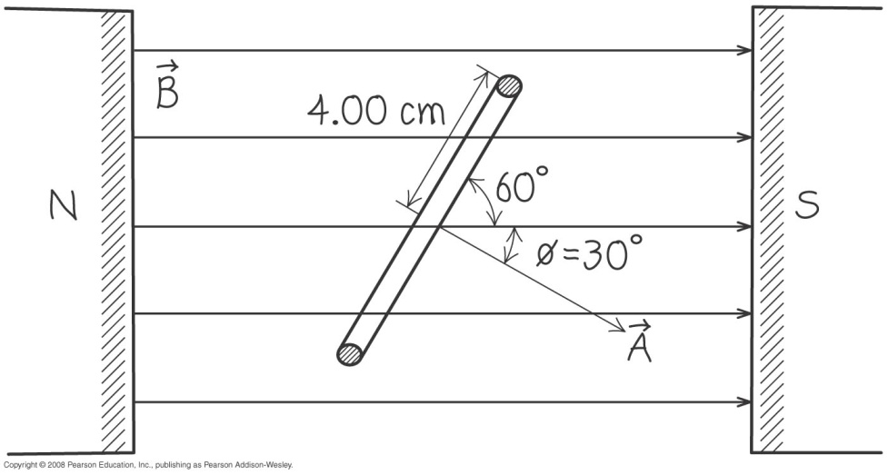
Example 2
A coil of wire containing 500 circular loops with radius 4.00 cm is placed between the poles of a large electromagnet where the magnetic field is uniform and at an angle of 60º with the plane of the coil. The field decreases at a rate of 0.200 T/s. What are the magnitude and direction of the induced emf?
Notes:
V = 0.435 V, looking in the direction of A, emf would be clockwise.

Slide 9
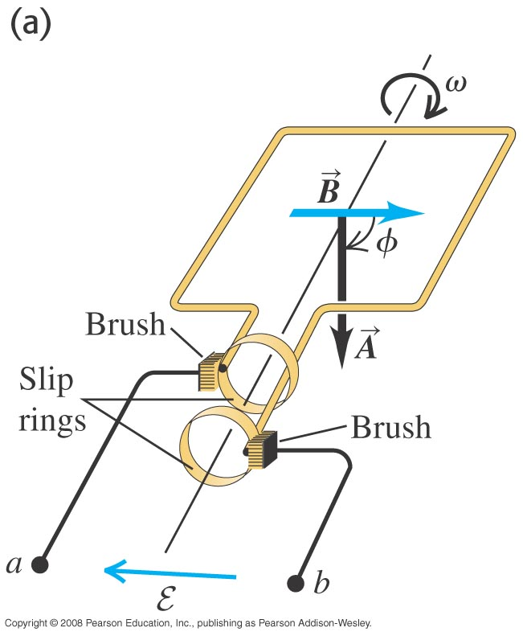
A simple alternator (a.c. generator)
A simple alternator consists of a rectangular loop rotating about an axis with constant angular speed ω.
An emf is produced because the magnetic flux through the loop changes as the loop rotates.
As the loop rotates, the angle φ between and increases at a constant rate ω.

Slide 10
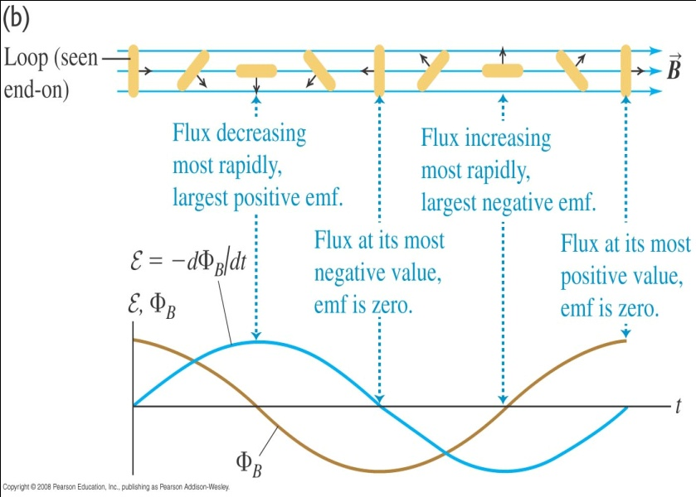
A simple alternator - cont
The flux through the coil is
The induced emf is
The absolute value of the induced emf is a maximum when Φ_{B} is zero and zero when the absolute value of Φ_{B} is a maximum.

Slide 11
A simple alternator - cont
The emf is supplied to the external circuit via two slip rings.
The amplitude of the emf can be increased by increasing the rotation speed, the field magnitude or the loop area or by using more loops.
One use of alternators is in automobiles to generate currents in the ignition and the lights.

Slide 12
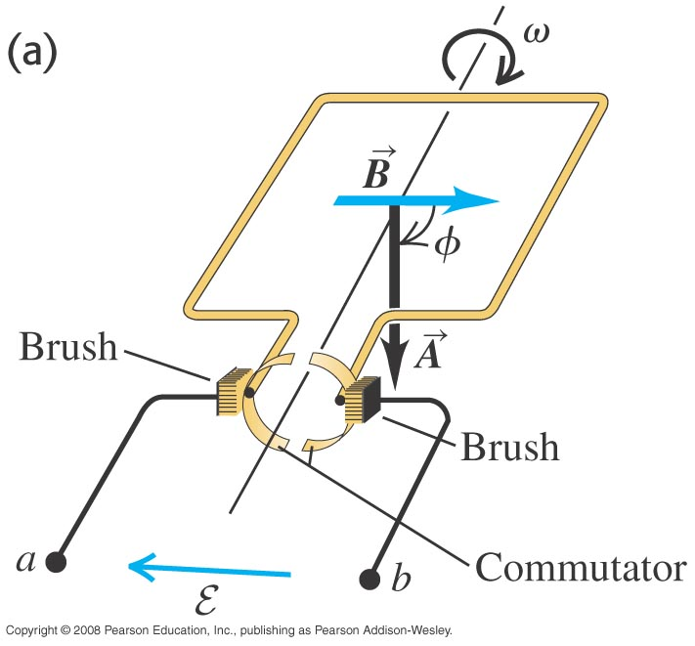
A direct current (d.c) generator
A direct current (dc) generator produces an emf that has the same sign throughout the rotation of the coil.
The working principle is identical to that of an alternator except that a split ring (commutator) is used instead two slip rings.
The split ring reverses the connections to the external circuit at angular positions where the emf reverses, thus producing an emf always in the same direction.

Slide 13
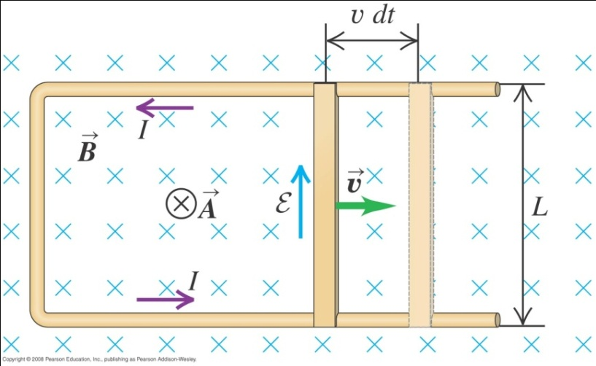
Example 3
The below figure shows a U-shaped conductor in a uniform magnetic field perpendicular to the plane of the figure directed into the page. A metal rod of length L is laid across the two arms of the conductor forming a circuit. If the rod is moved right with a constant velocity , an induced emf and current is set up. Find the magnitude and direction of the resulting induced emf. Note that this set up is also known as slidewire generator.
Notes:
V = -Blv, emf is directed counter clockwise around the loop.

Slide 14
Lenz’s law
Lenz’s law states that the direction of any magnetic induction effect is such as to oppose the cause of the effect.
The cause may be changing flux through a stationary circuit due to a varying magnetic field, changing flux due to motion of the conductors that make up the circuit or any combination.

Slide 15
Lenz’s law - variable magnetic field
If the flux in a stationary circuit changes, the induced current sets up a magnetic field of its own.
This field is opposite (same direction) to the original field if the original field is increasing (decreasing).
The induced current opposes the change in flux through the circuit.

Slide 16
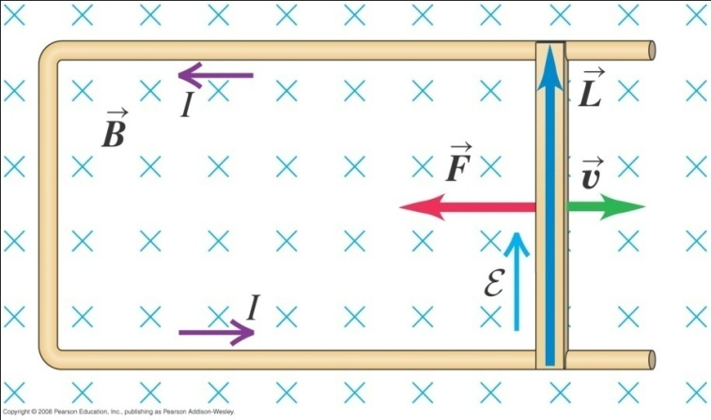
Lenz law – moving conductor
The direction of the induced current in the moving conductor is such that the direction of the magnetic-field force on the conductor is opposite in direction to its motion.
Thus the induced current tries to preserve the status quo by opposing motion or change of flux.

Slide 17
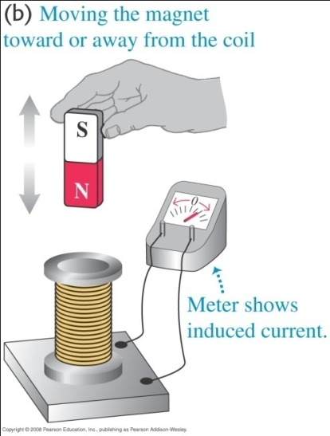
Lenz’s law – moving magnet
The induced magnetic field opposes the cause, which is the moving magnet.
Hence the induced magnetic field is in a direction so as to try to stop the moving magnet.
Otherwise, the induced magnetic field would increase the magnet's velocity and thereby increase its kinetic energy. This will contradict the law of conservation of energy.

Slide 18
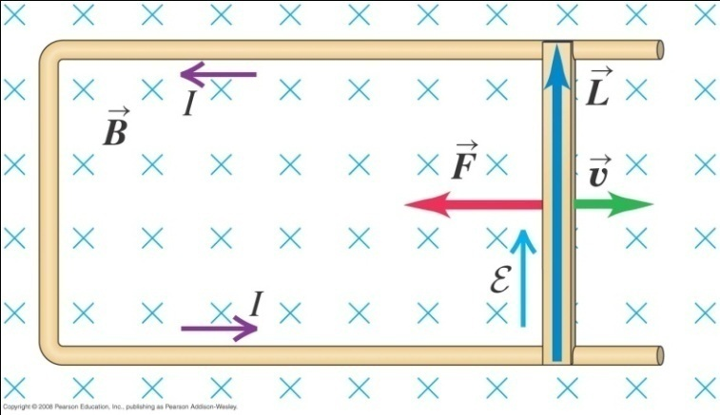
Example 4
In the slidewire generator (below figure), energy is dissipated in the circuit owing to its resistance. Let the resistance of the circuit (made up of the moving slidewire and the U-shaped conductor that connects the ends of the slidewire) at a given point in the slidewire’s motion be R. Show that the rate at which energy is dissipated in the circuit is exactly equal to the rate at which work must be done to move the rod through the magnetic field.

Slide 19
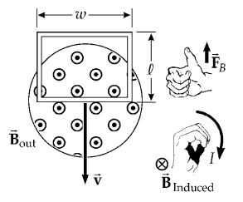
A conducting rectangular loop of mass M, resistance R, and dimension w by l falls from rest into a magnetic field as shown. During the time interval before the top edge of the loop reaches the field, the loop approaches terminal velocity v_{T} (when the weight = force on the induced current).
Show that

Slide 20
End of chapter

